Slide 1

to my presentation
This Photo by Unknown author is licensed under CC BY.

Slide 2

Ashfia Ahmed Oishy ID: 0242310011091047 Section : 29_A Department of Pharmacy

Slide 3
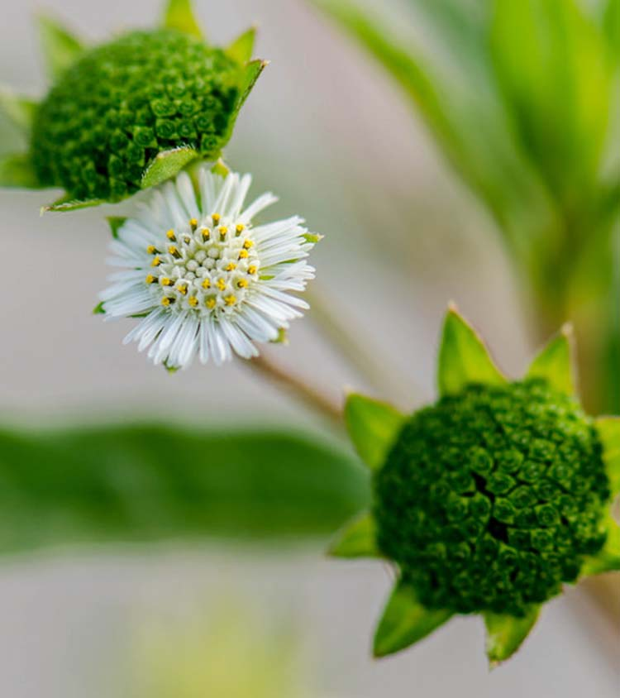
Presentation topic name:
Medicinal plant

Slide 4
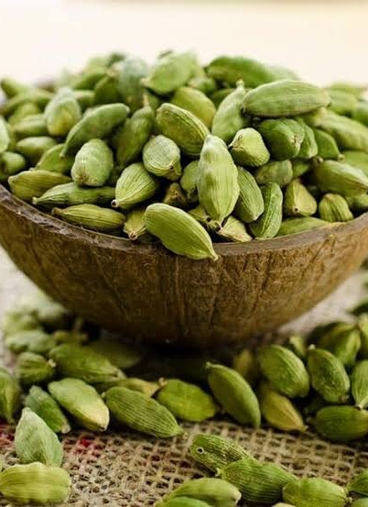
About Elachi:
Scientific name is Elettaria Cardamomum.
Elettaria cardamomum, commonly known as green or true cardamom, is a herbaceous, perennial plant in the ginger family, native to India. It is the most common of the species whose seeds are used as a spice called cardamom.

Slide 5
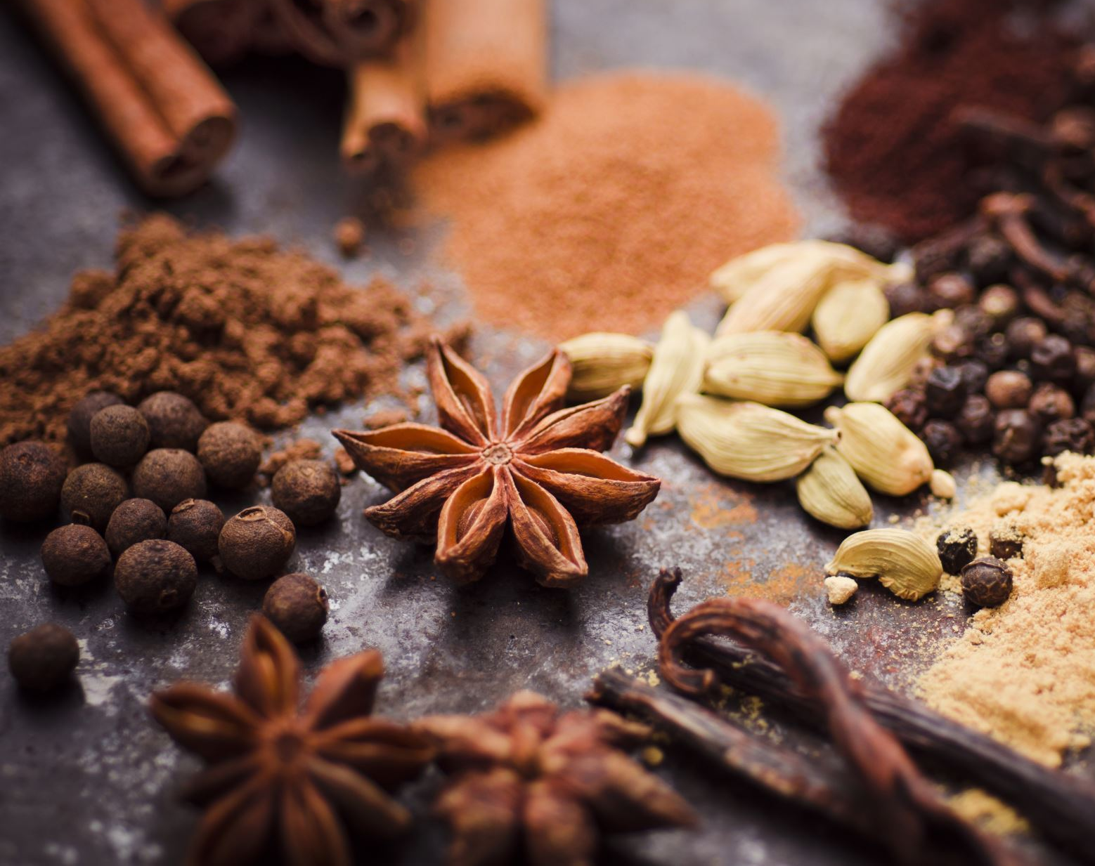
Scientific name – Elettaria Cardamomum Local name - Elachi English name – Cardamom, Malabar Cardamom

Slide 6
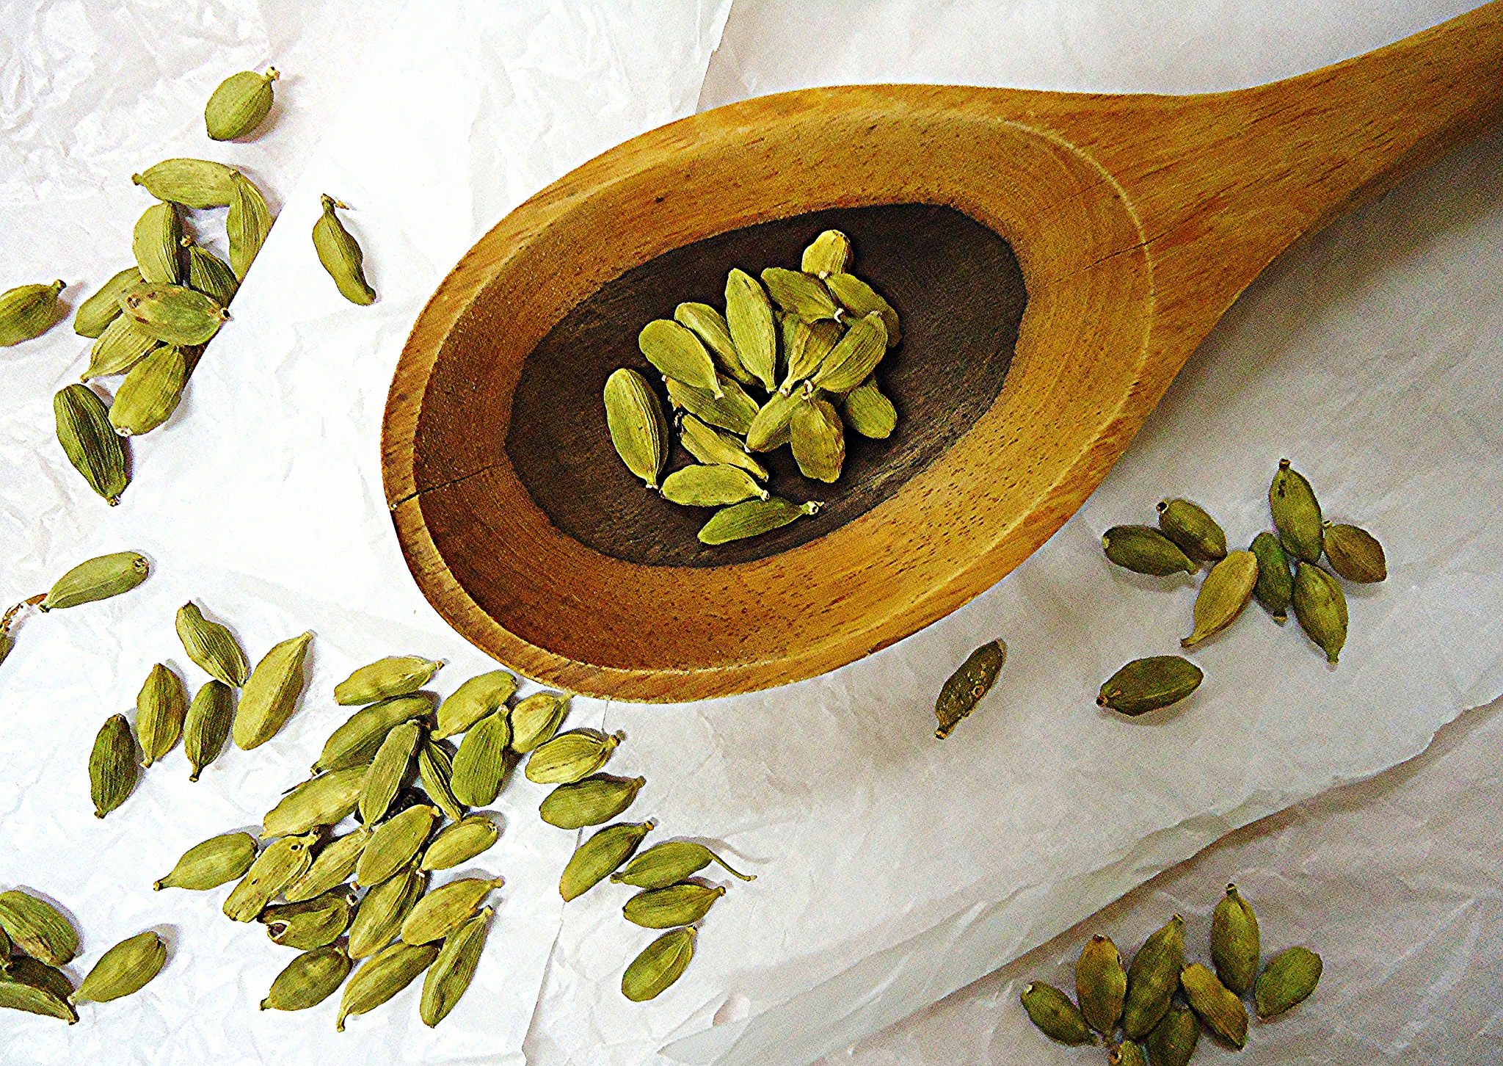
Taxonomy of Cardamom:
Kingdom: Plantae​ Class:Magnoliopsida​ Order: Zingiberales​ Family :Zingiberaceae​ Genus: Elettaria Maton-elettaria​ Species: E.Cardamomum​ ​

Slide 7
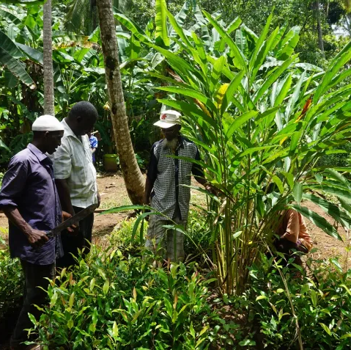
History & cultural Significance:
Cardamom fruits may be collected from wild plants, native to the forests of India, but most cardamom is cultivated in India, Sri Lanka.
Cardamom is considered to be one of the world 's oldest spices. The use of this spice dates back.

Slide 8

Medicinal Uses:
Cardamom is an herb.
The seeds are used to make medicine.
Cardamom is used for digestion problems including heartburn.
intestinal spasms.
intestinal gas.
Constipation.
liver and gallbladder complaints, and loss of appetite.

Slide 9

Potential side effects:
Some common side effects include allergies, contact dermatitis, increased risk and drug interactions. Caution is highly advised to minimize these side effects

Slide 10


